Slide 1
Chapter 8
Basic Concepts of Chemical Bonding

Slide 2
1. In ionic bond formation, the lattice energy of ions ________ as the magnitude of the ion charges _______ and the radii __________.
A) increases, decrease, increase
B) increases, increase, increase
C) decreases, increase, increase
D) increases, increase, decrease
E) increases, decrease, decrease
D

Slide 3
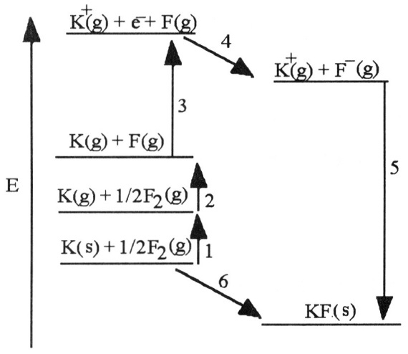
2. Which energy change corresponds to the electron affinity of fluorine __________?
A) 2
B) 5
C) 4
D) 1
E) 6
C

Slide 4
3. Which energy change corresponds to the first ionization energy of potassium __________?
A) 2
B) 5
C) 4
D) 3
E) 6
D

Slide 5
4. The type of compound that is most likely to contain a covalent bond is __________.
A) one that is composed of a metal from the far left of the periodic table and a nonmetal from the far right of the periodic table
B) a solid metal
C) one that is composed of only nonmetals
D) held together by the electrostatic forces between oppositely charged ions
E) There is no general rule to predict covalency in bonds
C

Slide 6
5. In which of the molecules below is the carbon-carbon distance the shortest __________?
A) H₂C=CH₂
B) H–C≡C–H
C) H₃C–CH₃
D) H₂C=C=CH₂
E) H₃C–CH₂–C H₃
B

Slide 7
6. Of the molecules below, the bond in __________ is the most polar.
A) HBr
B) HI
C) HCl
D) HF
E) H₂
D

Slide 8
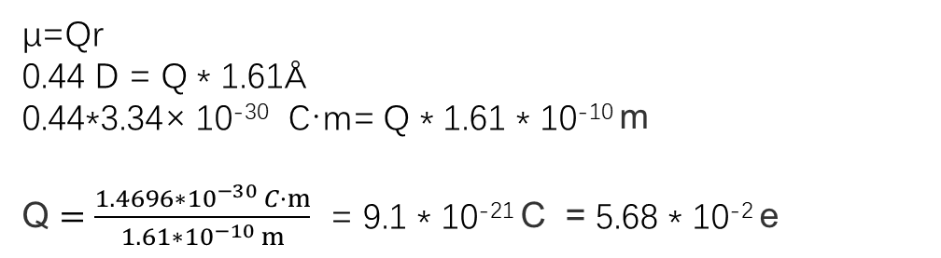
7. The bond length in an HI molecule is 1.61 Å and the measured dipole moment is 0.44 D. What is the magnitude (in units of e) of the negative charge on I in HI __________?
(1 debye = 3.34 × 10⁻³⁰ coulomb-meters; e=1.6 × 10⁻¹⁹ coulombs)
A) 1.6 × 10⁻¹⁹
B) 0.057
C) 9.1
D) 1
E) 0.22
B
1Å=10⁻¹⁰ m
μ=Qr
0.44 D = Q * 1.61Å
0.44*3.34× 10⁻³⁰ C·m= Q * 1.61 * 10⁻¹⁰ m
Q $=\frac{1.4696∗{10}^{−30} C·m}{1.61∗{10}^{−10} m}$ = 9.1 * 10⁻²¹ C = 5.68 * 10⁻² e

Slide 9
8. The ion PO₄³⁻ has __________ valence electrons.
A) 14
B) 24
C) 27
D) 29
E) 32
E
6*5+2=32

Slide 10
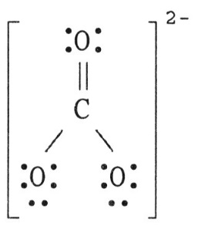
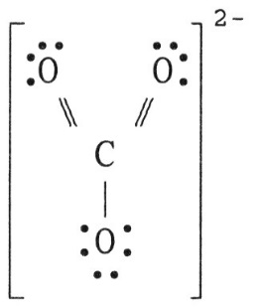
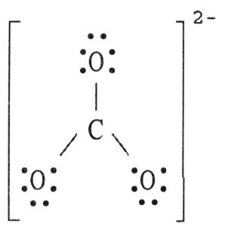
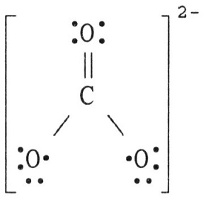
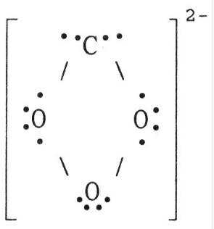
A
9. The Lewis structure of the CO₃²⁻ ion is __________.
A) B)
C) D)
E)

Slide 11
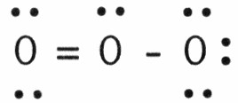
10. In the resonance form of ozone shown below, the formal charge on the central oxygen atom is __________.
A) 0
B) +1
C) -1
D) +2
E) -2
B
F_{O2} = 6 – 6/2 -2 = +1
F_{O1} = 6 – 4/2 -4 = 0
F_{O3} = 6 – 2/2 -6 = -1

Slide 12
11. To convert from one resonance structure to another, __________.
A) only atoms can be moved
B) electrons and atoms can both be moved
C) only electrons can be moved
D) neither electrons nor atoms can be moved
E) electrons must be added
C

Slide 13
12. Why don't we draw double bonds between the Be atom and the Cl atoms in BeCl₂ __________?
A) That would give positive formal charges to the chlorine atoms and a negative formal charge to the beryllium atom.
B) There aren't enough electrons.
C) That would result in more than eight electrons around beryllium.
D) That would result in more than eight electrons around each chlorine atom.
E) That would result in the formal charges not adding up to zero.
A

Slide 14
13. As the number of covalent bonds between two atoms increases, the distance between the atoms __________ and the strength of the bond between them __________.
A) increases, increases
B) decreases, decreases
C) increases, decreases
D) decreases, increases
E) is unpredictable
D

Slide 15
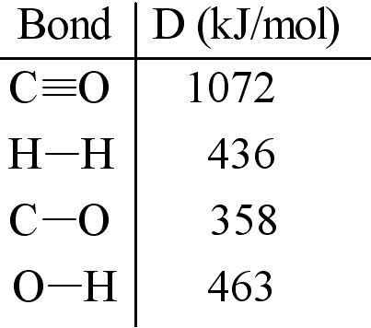
14. The reaction below is used to produce methanol:
CO (g) + 2H₂ (g) → CH₃OH (l) ΔHrxn = -128 kJ
(a) Calculate the C-H bond energy given the following data:
(b) The tabulated value of the (C-H) bond energy is 413 kJ/mol. Explain why there is a difference between the number you have calculated in (a) and the tabulated value.

Slide 16
Answer:
(a)
ΔHrxn = D(C≡O) + 2 D(H–H) - [3 D(C–H) + D(C–O) + D(O–H)]
3 D(C–H) = - ΔHrxn + D(C≡O) + 2 D(H–H) - D(C–O) - D(O–H)
D(C–H) = (128 + 1072 + 2(436) - 358 - 463)/3 = 417
D(C–H) = 417 kJ/mol
Note: Here the energy change regarding phase change of CH₃OH is ignored.
Though the enthalpy of the reaction, ΔHrxn, can be estimated as follows:
ΔHrxn=Σ(bond enthalpies of bonds broken) - Σ(bond enthalpies of bonds formed), this kind of estimation is only applied for the gas-phase reactions.
(b) Tabulated values, like those in Table 8.4, are averaged from many bond energies measured for C-H bonds in many different molecules.

